Slide 1
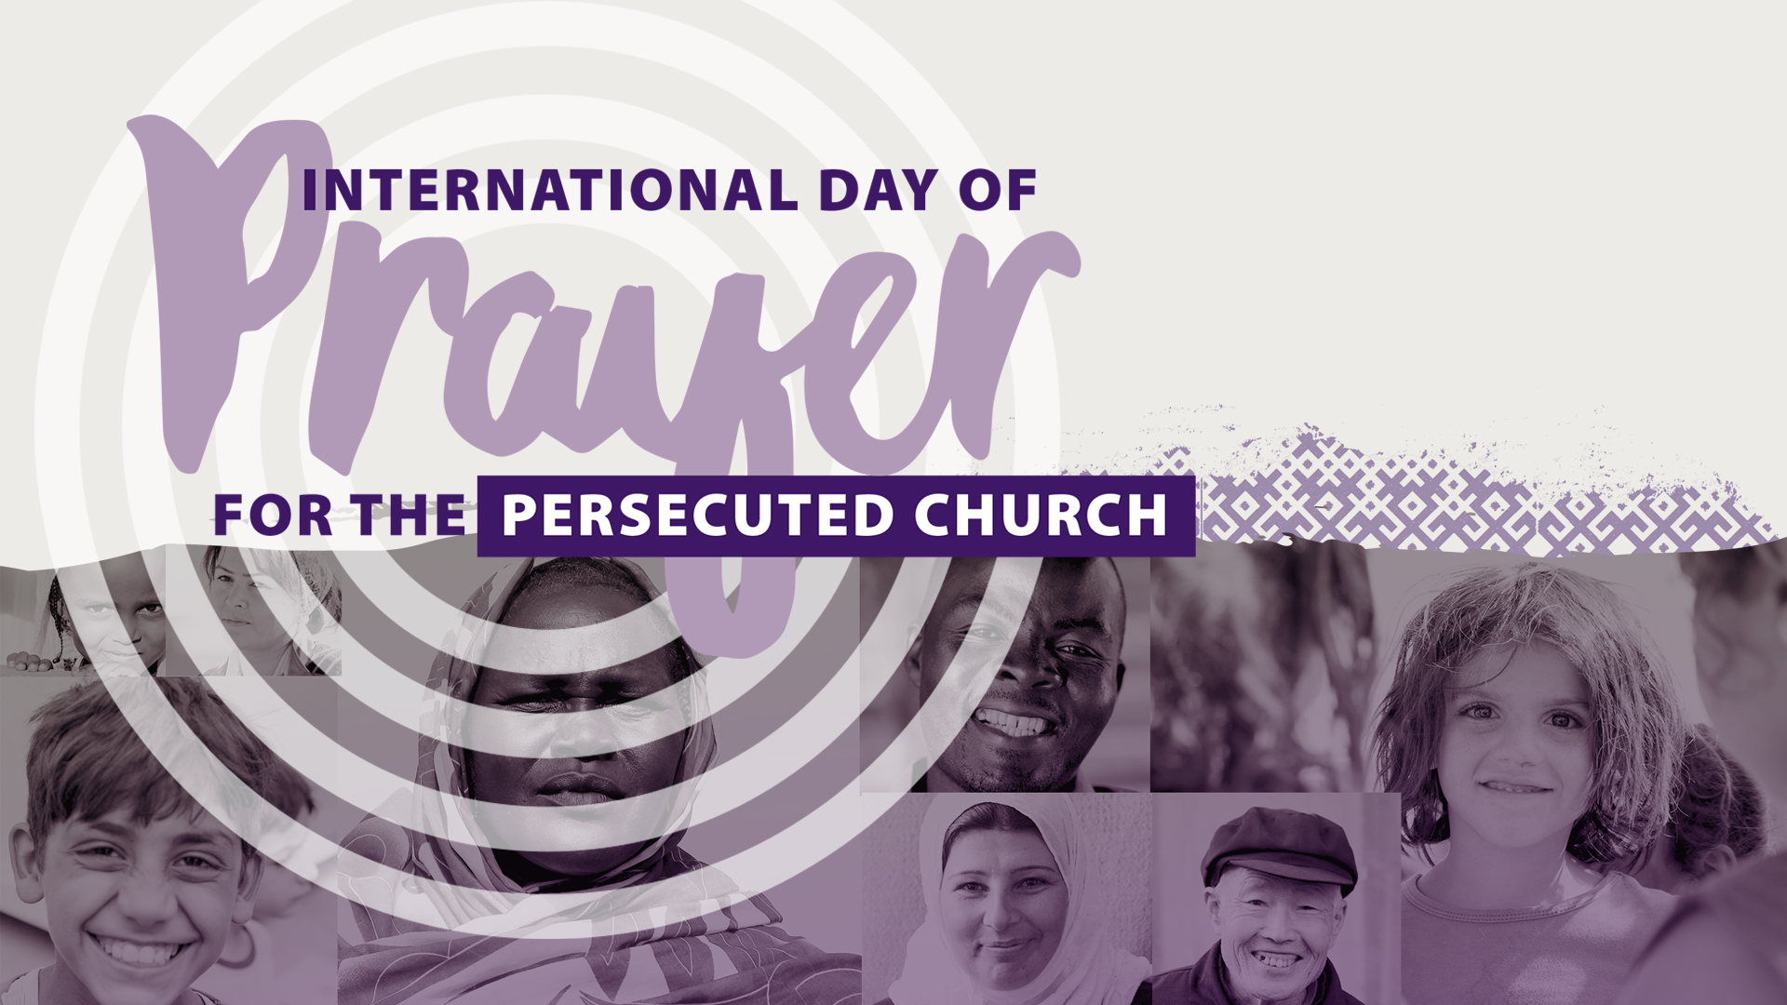

Slide 2

What is Christian Persecution?
Christian persecution is the systematic mistreatment of an individual or group of individuals because of their Christian faith.
It can come in the form of:
Physical abuse, torture, rape, mutilation, destruction of property, imprisonment and murder.
It can also come in the form of:
Cultural and societal discrimination, family excommunication, loss of job and income, loss of family and friends, inability to marry, prevention of education and many other forms.

Slide 3
Facts on Persecution
Christians are the most persecuted group in the world.
Every month, 322 Christians are killed for their faith in Jesus.
200 million Christians are facing persecution on a regular basis.
Every month, 214 Christian churches and properties are destroyed.

Slide 4
What We Can Do
Prayer is the number one request from persecuted Christians.
In America, more than 52 million attend church on a weekly basis. We can make an impact through our prayers, service, and giving.
The World Watch List (WWL) ranks the top 50 countries where Christian persecution is the most severe. See the top 50 countries and learn more facts and details about them at the Open Doors website.

Slide 5
Scripture
Psalm 82:3 Defend the weak and the fatherless; uphold the cause of the poor and the oppressed.
1 Corinthians 12:12-13 Just as a body, though one, has many parts, but all its many parts form one body, so it is with Christ. For we were all baptized by one Spirit so as to form one body—whether Jews or Gentiles, slave or free—and we were all given the one Spirit to drink.
Philippians 1:21 For to me, to live is Christ and to die is gain.
Matthew 5:44 But I tell you, love your enemies and pray for those who persecute you.
Psalm 46:10 He says, “Be still, and know that I am God; I will be exalted among the nations, I will be exalted in the earth.”
1 Thessalonians 5:11 Therefore encourage one another and build each other up, just as in fact you are doing.
Matthew 16:24 Then Jesus said to his disciples, “Whoever wants to be my disciple must deny themselves and take up their cross and follow me.”

Slide 6
Scripture
John 15:20 Remember what I told you: ‘A servant is not greater than his master.’ If they persecuted me, they will persecute you also. If they obeyed my teaching, they will obey yours also.
John 16:33 “I have told you these things, so that in me you may have peace. In this world you will have trouble. But take heart! I have overcome the world.”
Matthew 5:10-12 Blessed are those who are persecuted because of righteousness, for theirs is the kingdom of heaven. “Blessed are you when people insult you, persecute you and falsely say all kinds of evil against you because of me. Rejoice and be glad, because great is your reward in heaven, for in the same way they persecuted the prophets who were before you.”
Romans 5:3-4 Not only so, but we also glory in our sufferings, because we know that suffering produces perseverance; perseverance, character; and character, hope.
Philippians 1:12-14 Now I want you to know, brothers and sisters, that what has happened to me has actually served to advance the gospel. As a result, it has become clear throughout the whole palace guard and to everyone else that I am in chains for Christ. And because of my chains, most of the brothers and sisters have become confident in the Lord and dare all the more to proclaim the gospel without fear.

Slide 7
Biblical Lessons
Sometimes you need to build yourself a cell
Be still, and know that I am God—Psalms 46:10
One Chinese church leader, who spent 23 years in prison, once said this to Christians who did not face persecution:
"I was pushed into a cell, but you have to push yourself into one. You have no time to know God. You need to build yourself a cell, so you can do for yourself what persecution did for me—simplify your life and know God."
It is vital that we spend time with God, to grow in Him, so we are prepared to stand strong in the face of persecution.

Slide 8
Biblical Lessons
Weakness is a direct path to power
That is why, for Christ's sake, I delight in weaknesses, in insults, in hardships, in persecutions, in difficulties. For when I am weak, then I am strong—2 Corinthians 12:10
An Egyptian Christian reflected on the way he was treated when he converted to Christ:
"In great suffering you discover a different Jesus than you do in normal life… Pain and suffering bring up to the surface all the weak points of your personality. In my weakest state, I had an incredible realization that Jesus loved me even right then."
True empowerment does not come from human means, but through Christ alone. It often takes being at our weakest point to realize this.

Slide 9
Biblical Lessons
Extreme hurt requires extreme forgiveness
And Jesus said, "Father, forgive them, for they know not what they do." And they cast lots to divide his garments—Luke 23:34
A Christian widow from Iran said:
"I only had hatred in my heart for my enemies who had murdered my husband. But one day a miracle happened. God taught me how I could love my enemies… I had been praying for this, even though on the deepest level I didn't want it to happen. Gradually, through a process of ups and downs, God answered this prayer."
The only way we can get through extreme hurt is by forgiving people as Christ did.

Slide 10
Prayer Points
Pray that Christians would continue to shine for Jesus and share their testimony to their persecutors with boldness.
Pray that despite difficult trails, Christians would continue to have perseverance, endurance and persistence.
Pray that the churches in the United States would grow in awareness and support of persecuted Christians.
“Wake up! Strengthen what remains and is about to die, for I have found your deeds unfinished in the sight of my God.”
Revelation 3:2

Slide 11
